Slide 1
APUSH Review: Reconstruction
Everything You Need To Know For Your APUSH Exam

Slide 2
Reconstruction: An Intro
What was it?
Attempting to achieve national unification after the Civil War
Key questions regarding Reconstruction:
Who would control it? Congress? President?
How would South be treated?

Slide 3
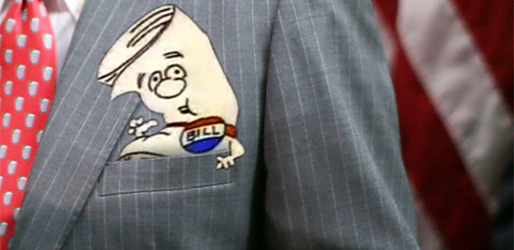
Lincoln vs. Congressional Reconstruction
Lincoln: Favorable to the South
Lincoln’s 10% Plan:
If 10% of voters in 1860 election pledged loyalty to US, state could be readmitted
Congress felt it was too lenient
Wade-Davis Bill:
Congress (Republicans) sought 50% of voters in 1860 election to pledge allegiance
Pocket-vetoed by Lincoln

Slide 4
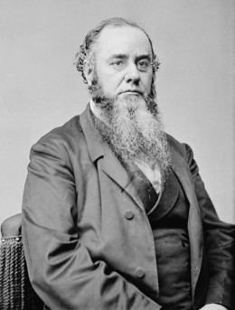
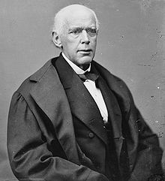
President Johnson
His Reconstruction Plan was similar to Lincoln
10%
Ratification of the 13th Amendment
Confederates could appeal to him for a pardon
Disliked by “Radical Republicans”
Johnson was a Democrat from the South
Impeached for violating Tenure of Office Act
Secretary of War Stanton
Johnson was not removed

Slide 5
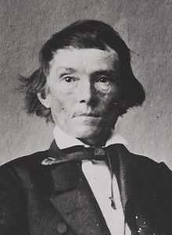
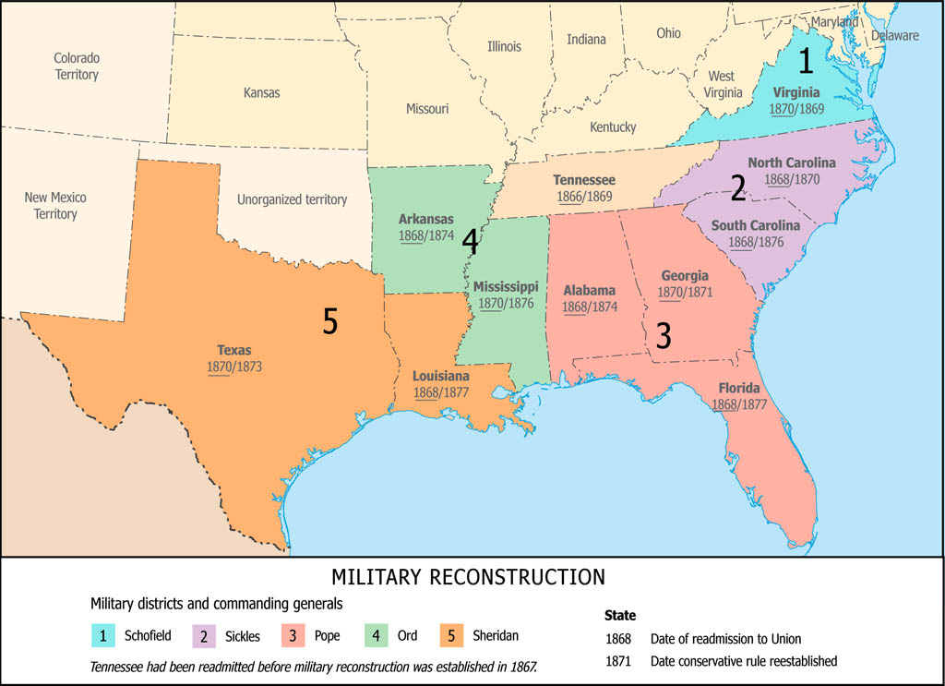
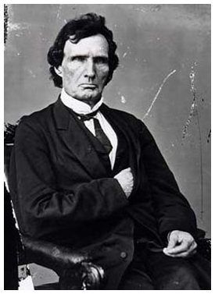
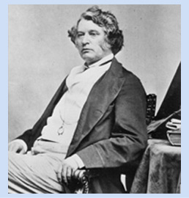
Why did “Radical” Reconstruction occur?
Congress (Republicans) wanted to maintain their power
2 key Congressmen: Thaddeus Stevens and Charles Sumner
Former Confederate officials ran for federal office
Former CSA VP Alexander Stevens
Black Codes
Regulated affairs of freedmen; conditions similar to slavery
South was divided into 5 military zones

Slide 6
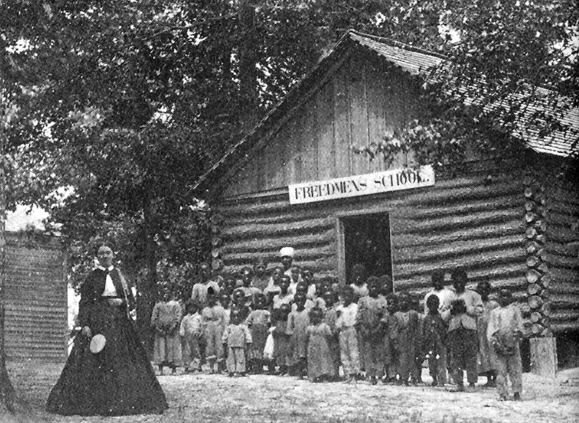
Freedmen’s Bureau
Goal:
Help former slaves survive and adjust
Food, medicine, and clothing were provided to former slaves and poor whites
Promised “40 Acres and a Mule”
Rarely happened
Biggest Success of the Freedmen’s Bureau?
EDUCATION!

Slide 7
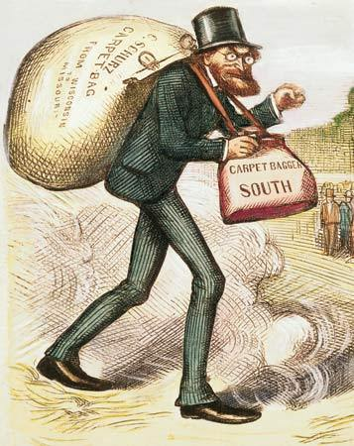
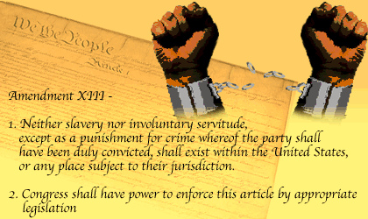
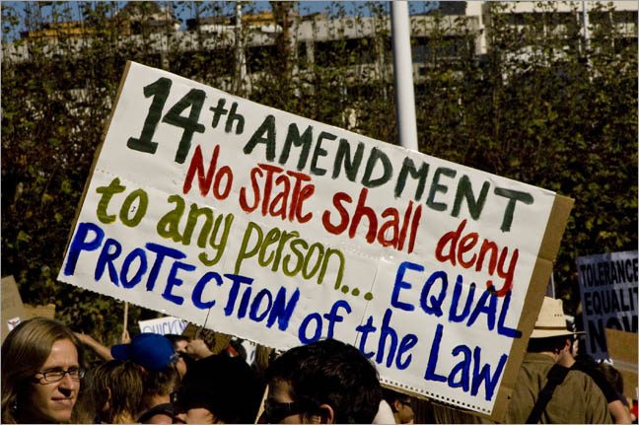
Key Reconstruction Amendments and Terms
13th Amendment:
Made slavery illegal
14th Amendment:
Granted citizenship to blacks
Equal protection for citizens
Former Confederate officers could not hold state or federal office
15th Amendment:
Granted suffrage for blacks
South found loopholes: poll taxes, literacy tests, etc.
Scalawags:
Southerners that favored Reconstruction
Carpetbaggers:
Northerners that moved South during Reconstruction
Force Acts:
Passed in response to KKK, Federal troops used to quell KKK

Slide 8
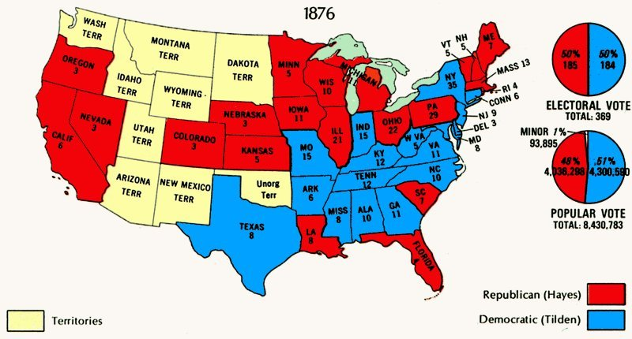
End of Reconstruction
Why did it end?
Compromise of 1877
The compromise settled the disputed 1876 election
Hayes (Republican) became President
ENDED MILITARY RULE IN THE SOUTH!
Southerner appointed to cabinet
Impact of end of Reconstruction?
Jim Crow Laws
Upheld by Plessy v. Ferguson
Disenfranchisement for blacks

Slide 9
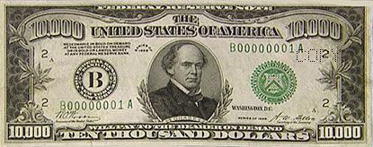
Thanks for watching!
Subscribe to my channel
Help spread the word
Good luck on your tests!
I’m representing Cincinnati!
Subscribe
Down here!

